Slide 1
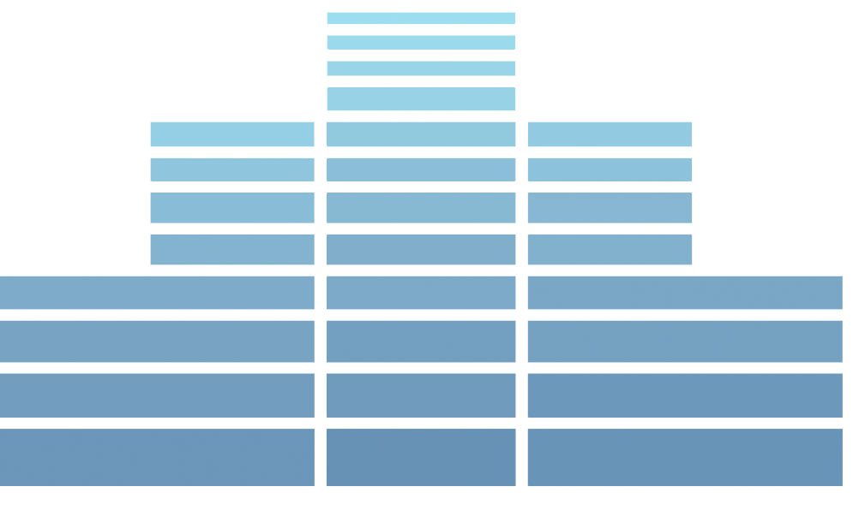
Financial Management Cost Principles
Paul Webster, Director
Stephen Kim, Financial Analyst
Financial Management Division
Community Planning and Development
HUD

Slide 2
Applicable Requirements
Cost Principles and Procedures - 2 CFR Part 200, Subpart E (and related appendices)
All costs, whether charged on a direct or indirect basis, are subject to the factors affecting the allowability of costs (§200.403)
General Provisions for Selected Items of Cost (§200.420 through §200.475)

Slide 3
Composition of costs (§ 200.402)
Total Costs of a Federal Award
=
+ Allowable Direct Costs
+ Allocable Indirect Costs
– Applicable Credits

Slide 4
Factors affecting allowability (§ 200.403)
(a) Be necessary and reasonable for the performance of the Federal award and be allocable thereto.
(b) Conform to any limitations or exclusions set forth in these principles or in the Federal award as to types or amount of cost items.
(c) Be consistent with policies and procedures that apply uniformly to both federally-financed and other activities of the non-Federal entity.
(d) Be accorded consistent treatment.
(e) Be determined in accordance with generally accepted accounting principles (GAAP), except, for state and local governments and Indian tribes only, as otherwise provided for in part 200.
(f) Not be included as a cost or used to meet cost sharing or matching requirements of any other federally-financed program in either the current or a prior period.
(g) Be adequately documented.
(h) Cost must be incurred during the approved budget period.

Slide 5
Reasonable Costs (§200.404)
Ordinary and necessary
Sound Business Practices
An arm’s length transaction
Market prices for comparable goods and services for the geographic area
Act with prudence
Whether the non-Federal entity significantly deviates from its established practices and policies

Slide 6
Allocable Costs (§200.405)
Is incurred specifically for the Federal award
Benefits both the federal award and other work of the non-Federal entity and is assignable in part to the Federal award in accordance with the Cost Principles in 2 CFR 200, Subpart E.
Is necessary to the overall operation of the nonfederal entity

Slide 7
Applicable Credits - Definition
§ 200.406 –Applicable credits refer to those receipts or reduction-of-expenditure-type transactions that offset or reduce expense items allocable to the Federal award as direct or indirect (F&A) costs. Examples of such transactions are: purchase discounts, rebates or allowances, recoveries or indemnities on losses, insurance refunds or rebates, and adjustments of overpayments or erroneous charges. To the extent that such credits accruing to or received by the non-Federal entity relate to allowable costs, they must be credited to the Federal award either as a cost reduction or cash refund, as appropriate.

Slide 8
Direct Costs - Definition
§ 200.413 Direct costs.(a) General. Direct costs are those costs that can be identified specifically with a particular final cost objective, such as a Federal award, or other internally or externally funded activity, or that can be directly assigned to such activities relatively easily with a high degree of accuracy.
Costs incurred for the same purpose in like circumstances must be treated consistently as either direct or indirect (F&A) costs.

Slide 9
Examples of Direct Costs
Salaries, wages, and benefits of employees directly performing services related to a specific project or cost objective
Travel costs incurred in the performance of direct services

Slide 10
Examples of Unallowable Costs
Alcoholic beverages - § 200.423
Bad debts (debts which have been determined to be uncollectable) - § 200.426
Meals for social activities- § 200.438

Slide 11
Questions to be Answered
What are indirect costs?
How are they documented?
How are they recovered?

Slide 12
Some Background on Cost Classification
Costs can be classified in various ways, depending on the purpose.
Economists and accountants often find it useful to establish binary classifications of costs.
Under such classifications, costs are included in one category or the other. (e.g., either direct or indirect)

Slide 13
Cost Classification Examples

Slide 14
Key Terms
Indirect Costs
Cost objective
Indirect cost rate
10% de minimis rate
Indirect cost rate proposal
Cognizant Agency
Central service cost allocation plan

Slide 15
Points to Keep in Mind
Indirect costs tend to be support costs (e.g., telephone, printing, rent) as opposed to costs that can be traced directly to projects or activities (e.g., construction costs for public facilities).
Indirect costs are real and have to be paid from some revenue source for an organization to function.
For most HUD grantees, allocation of indirect costs does not increase total funding.

Slide 16
Indirect (F&A) Costs -Definition
§ 200.414 - Indirect (F&A) costs means those costs incurred for a common or joint purpose benefitting more than one cost objective, and not readily assignable to the cost objectives specifically benefitted, without effort disproportionate to the results achieved.
-Indirect costs can be defined as any costs incurred by a recipient or subrecipient that cannot be traced directly to a cost objective.

Slide 17
Examples of Indirect Costs
General and Administrative salaries and wages
Office building security services
Office supplies
Depreciation
Rent

Slide 18
Cost Objective
- Cost objective means a program, function, activity, award, organizational subdivision, contract, or work unit for which cost data are desired and for which provision is made to accumulate and measure the cost of processes, products, jobs, capital projects, etc. A cost objective may be a major function of the non-Federal entity, a particular service or project, a Federal award, or an indirect (Facilities & Administrative) cost activity, as described in Subpart E-Cost Principles.
- A typical cost objective is a HUD award, project, or activity.

Slide 19
CDBG Cost Objective Examples
CD Dept.
Project A
Project B
B-16-xx
Project A
Project B
B-15-xx
Activity 1
Activity 2
Activity 3
Activity 1
Activity 2
Activity 3
Activity 1
Activity 2
Activity 3
Activity 1
Activity 2
Activity 3

Slide 20
Indirect Cost Rate
Indirect costs ÷ Direct cost base
(expressed as a percentage)
Acceptable direct cost bases:
Direct salaries and wages including (or excluding) all fringe benefits.
Direct salaries and wages including vacation, holiday, sick pay, and other paid absences but excluding all other fringe benefits.
Total Direct Costs (TDC)
Modified Total Direct Costs (MTDC)

Slide 21
Types of Indirect Cost Rates
Provisional
Final
Fixed (with carry forward)
Predetermined

Slide 22
10% De Minimis Rate
§200.414 Indirect (F&A) costs.
(f) In addition to the procedures outlined in the appendices in paragraph (e) of this section, any non-Federal entity that does not have a current negotiated (including provisional) rate, except for those non-Federal entities described in appendix VII to this part, paragraph D.1.b, may elect to charge a de minimis rate of 10% of modified total direct costs (MTDC) which may be used indefinitely. No documentation is required to justify the 10% de minimis indirect cost rate. As described in §200.403, costs must be consistently charged as either indirect or direct costs, but may not be double charged or inconsistently charged as both. If chosen, this methodology once elected must be used consistently for all Federal awards until such time as a non-Federal entity chooses to negotiate for a rate, which the non-Federal entity may apply to do at any time.

Slide 23
10% De Minimis Rate cont’d
Modified Total Direct Cost (MTDC)
MTDC means all direct salaries and wages, applicable fringe benefits, materials and supplies, services, travel, and up to the first $25,000 of each subaward (regardless of the period of performance of the subawards under the award). MTDC excludes equipment, capital expenditures, charges for patient care, rental costs, tuition remission, scholarships and fellowships, participant support costs and the portion of each subaward in excess of $25,000. Other items may only be excluded when necessary to avoid a serious inequity in the distribution of indirect costs, and with the approval of the cognizant agency for indirect costs.

Slide 24
Government Wide Central Service Cost Allocation Plan
Appendix V to Part 200—State/Local Governmentwide Central Service Cost Allocation Plans
Governmental units provide certain services, such as motor pools, computer centers, purchasing, accounting, etc., to operating departments or agencies on a centralized basis.
Plan identifies central service costs and assigns them to operating departments (or other sub-units) on a reasonable and consistent basis
Major local gov’t means local gov’t that receives more than $100 million in direct Federal awards subject to this Part.

Slide 25
Indirect Cost Rate Proposal (ICRP)
Indirect cost rate proposal means the documentation prepared by a non-Federal entity to substantiate its request for the establishment of an indirect cost rate as described in appendices III through VII and appendix IX to 2 CFR part 200.

Slide 26
Indirect Cost Rate Proposal - cont’d
Typically, the ICRP for a governmental entity covers an operating department or agency.
ICRP for nonprofit organization may cover entire operation.
Indirect costs included in ICRP consist of:
-Central service costs allocated to the unit (if it is a governmental unit), and
-Indirect costs of department/agency/organization

Slide 27
Cognizant Agency Determination
Guidance on determining cognizance provided in Appendix V to Part 200 - State/Local Governmentwide Central Service Cost Allocation Plans.
NOTE: Cognizance for Central Service Cost Allocation Plan may be different than cognizance for an Indirect Cost Proposal for a department of the governmental unit.
Some Federal agencies are always cognizant for certain categories of governmental units (e.g., HUD is cognizant for state and local housing and development districts).

Slide 28
Preliminary Steps - Documentation
Organization review
Review Federal and non-Federal funding
Review accounting structure
Prepare cost policy statement
Prepare indirect cost proposal
Submit to cognizant agency (or retain for review)

Slide 29
Submission Requirements Government Wide Central Service Cost Allocation Plans
Major Local Government
-a “major local government” is required to submit plan to its cognizant agency annually
-major local government: receives more than $100 million in direct Federal awards
-other local governments claiming central service costs must develop a plan in accordance with Appendix V and maintain the plan and related supporting documentation for audit
Timing
-prepared and, when required, submitted within six months prior to the beginning of each of the governmental unit's fiscal years in which it proposes to claim central service costs.

Slide 30
Submission Requirements Indirect Cost Rate Proposal (ICRP) Governmental Entity
Governmental department/agency receiving more than $35 million in direct Federal funding must submit ICRP to its cognizant agency.
Other departments/agencies must prepare proposal and hold for review.
ICRP must be developed (and, when required, submitted) within six months after the close of the governmental unit's fiscal year.

Slide 31
Submission Requirements ICRP from Nonprofit Organization
A nonprofit organization which has not previously established an indirect cost rate with a Federal agency must submit its initial ICRP immediately after the organization is advised that a Federal award will be made and, in no event, later than three months after the effective date of the Federal award.
Organizations that have previously established indirect cost rates must submit a new ICRP to the cognizant agency for indirect costs within six months after the close of each fiscal year.

Slide 32
Submission Instructions
If HUD is determined to be the cognizant agency and submission of Central Services Plan or ICRP is required, it should be submitted by the grant recipient to the CPD Division in the appropriate field office.
The CPD field office should forward the documentation to HUDCPDIndirectCostRates@hud.gov for submission to the Department of Health and Human Services (HHS).

Slide 33
Recovering Indirect Costs
When using a rate specified in ICRP:
Submit claims/drawdowns using the rate negotiated with the cognizant agency or the rate in the indirect cost proposal prepared and held for review
Apply indirect cost rate to direct cost base (i.e., direct costs incurred under the grant being charged for indirect costs)
Maintain documentation for audit purposes

Slide 34
Recovering Indirect Costs cont’d
When using a 10% de minimis rate:
Submit claims/drawdowns using the 10% de minimis rate
Apply de minimis rate to MTDC (incurred under grant being charged for indirect costs)
Maintain documentation for audit purposes

Slide 35
Limitations
Amount recovered may be affected by statutory or regulatory limitations.
For example, CDBG recipients may not be able to recover amount of indirect costs otherwise allocable to a grant if it would cause the recipient to exceed the cap on general administrative costs.

Slide 36
Thank you!
Qs & As

